Slide 1
Sentiment Analysis For Marketing Using CNN
Done By:
Ramprawin.U
Rajavarman.A
Vishwa.P
Surya.R
Vishal.s

Slide 2
TABLE OF CONTENTS
01
02
Introduction
CNN Approach
03
04
Proposed method
Result
05
Conclusion

Slide 3
01
Introduction

Slide 4
Introduction :
Twitter, a popular social media platform with over 100 million active users and 140 million tweets sent daily, is an ideal platform for extracting general public opinion on specific issues. Twitter data is useful for sentiment analysis, such as opinion mining or natural language processing. Machine learning approaches, such as deep learning models, have achieved great results in computer vision and speech recognition. CNN (Convolutional Neural Networks) has archived impressive results in image recognition and natural language processing. This paper proposes an approach to parsing Twitter data to understand real-world situations using a CNN model for sentiment analysis. CNN can extract features from global information, allowing for the extraction of multi-pixel data information. This approach can be applied to computer vision, such as image analysis, where it can extract a part of pixel data information, allowing for the training of input features in an effective way. The paper is organized into sections introducing the proposed approach, choosing the key model, describing experiment data, method, and results, and concluding with the conclusion and future plans.

Slide 5
02
CNN Approach

Slide 6
CNN Approach:
CNN uses the so-called convolutional filtering techniques, which automatically learn features appropriate for the given job, in one of the existing experiments using deep learning to classify texts. It has been demonstrated that a single convolutional layer or a combination of convolutional filters may achieve comparable performance even without any special hyperparameter adjustment. For instance, if we use CNN for sentiment classification, the convolutional filters may capture the inherent syntactic and semantic features of sentimental expressions. Additionally, linguistic structure expertise in a target language is not required by CNN. These benefits have allowed the CNN to be effectively used for a number of text studies, including sentence modelling, semantic parsing, and query-based search. Because it maintains the word sequence's order, one may contend that the Recurrent Neural Network (RNN) performs better for text categorization than the CNN. On the other hand, the CNN may also recognize sequential patterns; for instance, machine translation has effectively used convolutional filters in conjunction with the attention strategy. Additionally, the CNN is trainable with a limited amount of data because it often has fewer parameters than the RNN. CNN is renowned for delving into the depths of pertained word embeddings. In this research, we develop a CNN model for sentiment categorization and provide experimental findings demonstrating the superiority of our network over other deep learning models

Slide 7
03
Proposed Method

Slide 8
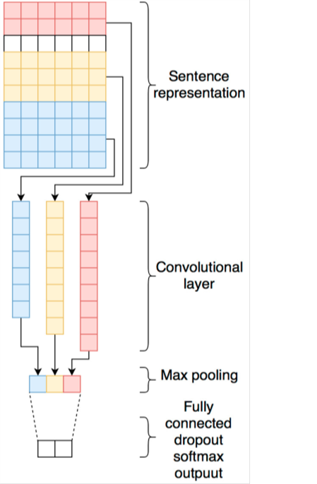
Proposed Method
CNN, which has been used on a large number of image datasets, works by moving the "convolutional" filter—that is, the kernel—through the image to extract its most important properties. The CNN function may also be applied in the text if the input data were provided as one-dimensional. Important features are retrieved, and local textual information is kept in the text area while the filter is moving. CNN is therefore a useful tool for text classification. An embedding layer, two convolutional layers, a pooling layer, and a fully connected layer made up the network. To make the sentence vectors a fixed size, we padded them. In other words, too long sentences were trimmed to a certain length, and the [PAD] token was appended to too short sentences.

Slide 9
04
Results

Slide 10
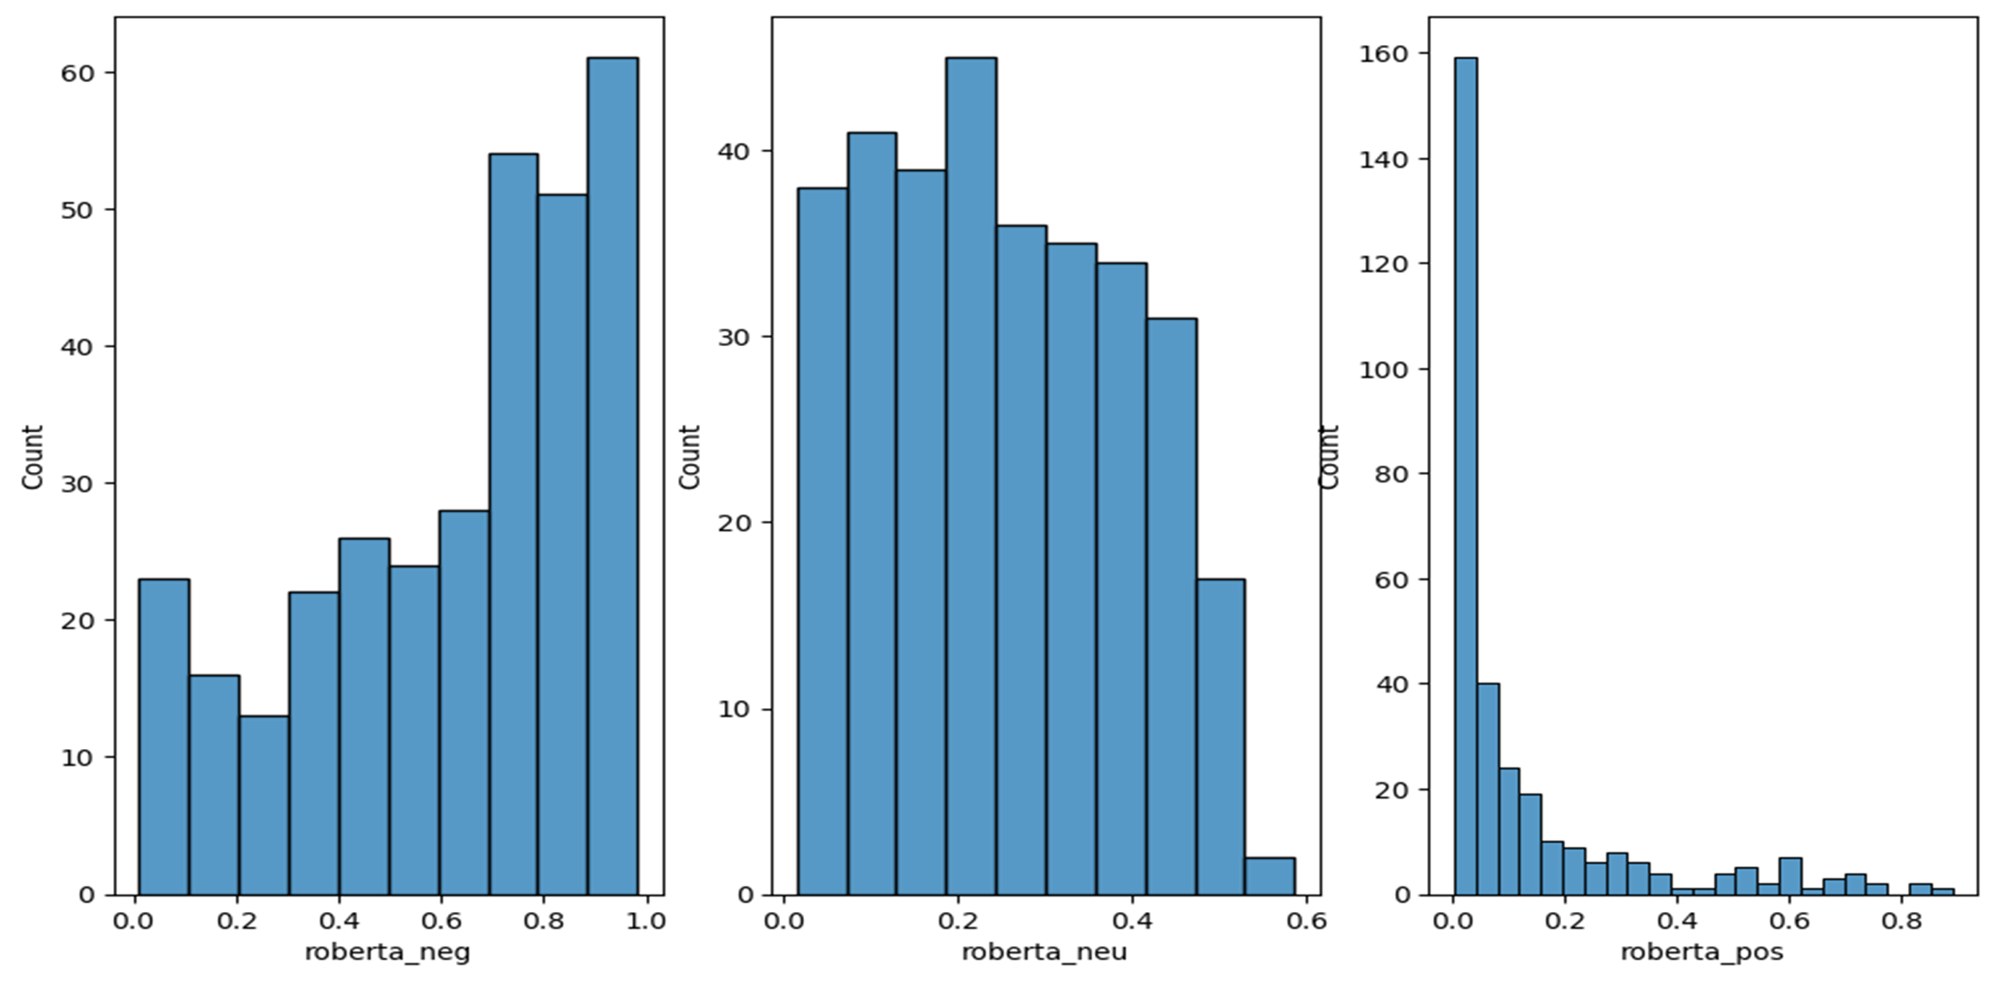
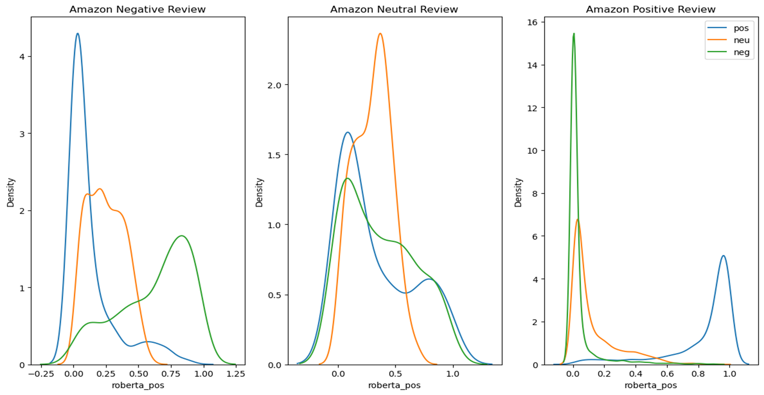
Results :
BAR GRAPH
LINE GRAPH

Slide 11
05
Conclusion

Slide 12
Conclusion :
In our current work, we have proposed a method for sentiment analysis of Amazon data. In this method, we build a convolutional neural network for text-based sentiment analysis. Numerous other studies could be conducted, including a closer look at the word2vec tool, multilayer convolutional neutral networks, bigger training datasets, and other situational or status analyses.

Slide 13
THANK YOU
HAPPINESS
SADNESS
SURPRISE
AFRAID
ANGER

